Slide 1

课时练习
模块六 第一章 读写综合训练

Slide 2
一、完形填空。
Bill and Cathy wanted to go on holiday. They chose Maldives(马尔代夫). And they decided to 1 .there for two weeks in spring, because they heard that the weather there would be perfect at that time. They worked very hard for several months. Finally, they made enough money for their dream 2 . But it was more like a nightmare(噩梦)!
1. A. work B. stay C. run
2. A. trip B. work C. clothes
B
A

Slide 3
一、完形填空。
B
The 3 began when the flight(航班) was put off because of bad weather. They couldn’t leave 4 . night. Twelve hours later, they finally 5 the plane! But they still couldn’t fly to Maldives because there was a storm. They had to fly to another city instead.
3. A. question B. problem C. dream
4. A. when B. until C. after
5. A. got on B. got up C. got off
B
A

Slide 4
一、完形填空。
C
There they stayed in a small hotel 6 the airport(机场).
The hotel was next to the sea, but the sea was so 7 .that they couldn’t swim in it. And the hotel swimming pool was full of leaves! The food was terrible too. For breakfast, there was 8 .
6. A. across B. from C. near
7. A. wide B. clear C. dirty
8. A. only B. much C. any
C
A

Slide 5
一、完形填空。
bread and milk! The worst part was when the storm came, they felt really terrible. Because of the bad weather, they had to stay for 9 night in the small hotel. And they had 10 to do. It was so boring. Finally, they arrived in Maldives three days later. And someone told them the weather there had been wonderful all the time!
9. A. others B. other C. another
10. A. something B. nothing C. everything
C
B

Slide 6
二、阅读理解。
If you like shopping and you are crazy about fashion(时尚), London is a good place for you. In London, you can buy not only the most expensive clothes, but also beautiful clothes which are inexpensive.
Many of the world’s most famous fashion designers(设计师) have their own shops in London. And every year in February and September, there

Slide 7
二、阅读理解。
is an important fashion event. It is called London Fashion Week and people all over the world come here and enjoy England’s wonderful new clothes. Usually the clothes are sold at a high price and they’re always in style(时髦的). In the 1960s, a fashion designer Mary Quant invented the mini-skirt. It made her famous all around the world. Later, in the 1970s, came punk fashion.

Slide 8
二、阅读理解。
Outside London there are some shopping centers as well. In the shopping streets of most towns, there’s a Market Day. On that day, some of the streets are filled with stalls(货摊) selling food, flowers, dresses, hats and bags and many other different things. The clothes there are always at a low price. Nearly everybody can afford them.

Slide 9
二、阅读理解。
( )1. When did punk fashion come into being?
A. In the 1950s. B. In the 1960s.
C. In the 1970s. D. In the 1980s.
C

Slide 10
二、阅读理解。
( )2. On a Market Day, people in London ______ from stalls.
A. can buy flowers, hats and bags
B. can’t buy food
C. can buy some expensive clothes
D. can’t find low-price clothes
A

Slide 11
二、阅读理解。
( )3. What does the underlined word “afford” mean in Chinese?
A. 买不到 B. 收购
C. 负担得起 D. 支付不起
C

Slide 12
二、阅读理解。
( )4. After reading the passage we can know _____.
A. who started London Fashion Week
B. who invented the mini-skirt
C. why punk fashion was in style
D. when Mary Quant was born
B

Slide 13
二、阅读理解。
( )5. What’s the best title for the passage?
A. Stalls selling clothes B. Clothes in fashion
C. London fashion week D. Shopping in London
D

Slide 14
三、短文填空。
Once upon a time, a rich man wanted to make a trip to 1 /ə'nʌðə(r)/ town. He needed to take many things 2 him, so he decided to take ten servants(仆人) to help him. They would carry the things to sell and the food to eat on their trip. Before they started, a little boy 3 ./ræn/ up to the rich man and asked to go with them.
another
with
ran

Slide 15
三、短文填空。
The rich man said to the little boy, “Well, you may go with 4 (we). But you are the smallest, thinnest and weakest of all my servants, you can’t carry a heavy load(担子). You must choose the 5 .(light) one to carry.” The boy thanked the rich man. However, he 6 (choose) the biggest load to carry at last. That was bread.
us
lightest
chose

Slide 16
三、短文填空。
“You are stupid,” said the rich man. “That is the biggest and the heaviest one.” But the boy said 7 ./'nʌθɪŋ/ and carried the load 8 .(happy). They walked for days on the trip and finally they got to the town. All the servants were tired 9 the little boy. Why? Most of the bread was eaten during the trip and a little was left 10 they arrived at the town. What a clever boy!
nothing
happily
except
when

Slide 17
四、书面表达。
你的同学林琳因为家境贫寒而上不起学，为了帮她筹钱，你们班组织(organize)了一次活动，希望能帮助林琳重返校园。请根据以下思维导图的提示写一篇英语短文，描述此次活动。（70词左右，可适当发挥）

Slide 18
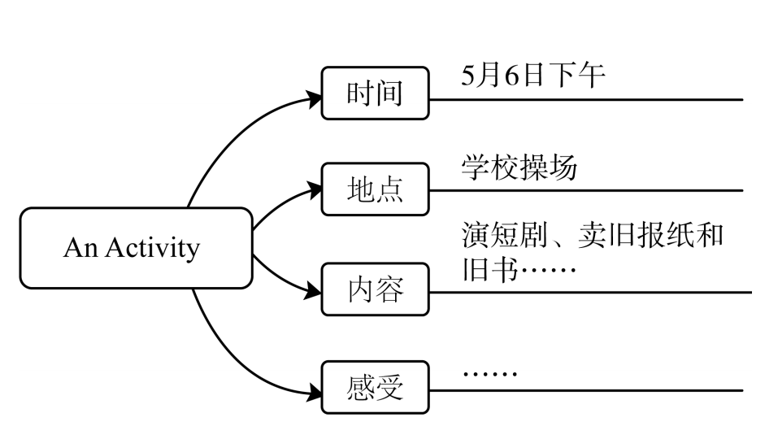
四、书面表达。

Slide 19
四、书面表达。
My classmate Lin Lin can’t go to school because her family is very poor. To raise money to help her, on the afternoon of May 6, our class organized an activity on our school playground. Some students put on a short play and others sold old newspapers and books. At last, we raised about 10,000 yuan. We were tired, but we felt happy. We hope the money can help Lin Lin.

Slide 20


